Slide 1
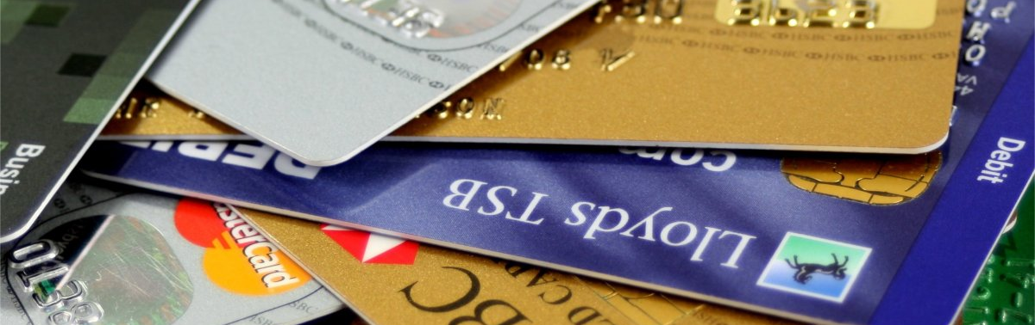
Micro-Credit Defaulter Project
SUDHANSHU KUMAR

Slide 2

Project Information
This Project is very interesting as it includes a real time problem for MFI. MFI stands for Micro-Finance Institution which offers financial services to low-income populations. Many MFI , experts and donors are supporting the ideas of using Mobile Financial Services(MFS). MFI provides a Micro-Credit Loan on mobile balances to the poor families in remote area which is to be paid in 5 days.
If a consumer unable to pay back the loan amount, it will be mark as defaulter.
For the loan amount of 5 (in Indonesian Rupiah), payback amount should be 6 (in Indonesian Rupiah), while, for the loan amount of 10 (in Indonesian Rupiah), the payback amount should be 12 (in Indonesian Rupiah).
We need to find target customers who can payback the credit on time. This can be observed by their avg usage of Mobile and their credibility of repayment.

Slide 3

What is Micro Credit?
Micro Credit, a value-added service designed on the premise of “what the consumer needs”, provides ease of access of airtime stock credit to resellers of a telecom operator when they run out of balance, without disrupting the normal flow of business. Micro Credit is an open and transparent service with a clear reporting structure. The telecom operator incurs zero cost, capital expenditure or credit risk as all investment is managed and handled by SDS.

Slide 4

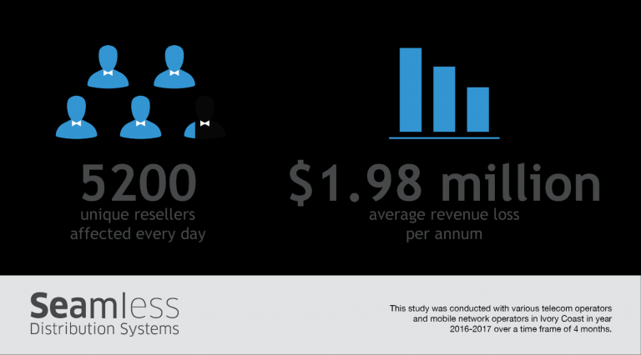
WHY MICRO CREDIT?
To understand the implications of this issue, the study details that on average 5200 unique resellers of one operator are affected every day. Due to lack of credit, these resellers were then unable to carry out airtime topup transactions, resulting into a total loss of about USD 1.98 million per annum for the operator. Such losses can be avoided if service providers can ensure service continuity despite the low stock at reseller’s end. Micro Credit is just the solution that can help them regain this lost value.

Slide 5


CALL ME BACK!
In case of subscribers or end consumers of telecom operators, this service is one step ahead of the Call Me Back feature that allows a subscriber to send a message to another subscriber to call him back in case he lacks the airtime to make the call himself.

Slide 6
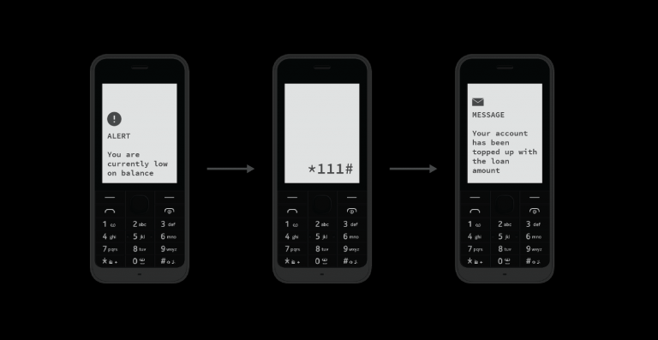
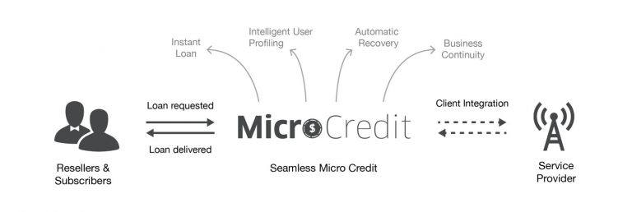
How it works?
With proven experience in managing high volume transactions, SDS acts as a virtual strategic dealer and provides instant loan to ensure reseller business continuity at all times. This dynamic service is powered by intelligent user profiling and is capable of recovering the loan amount automatically at the time of next recharge.
To get a limited amount of loan, resellers dial a pre-defined USSD short code. Micro Credit system receives the request and after performing various verifications and validations, processes the disbursement of loan amount accordingly.

Slide 7
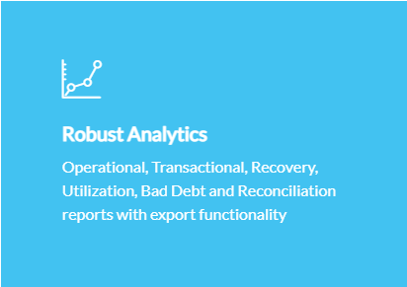
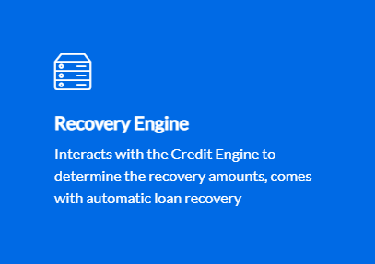
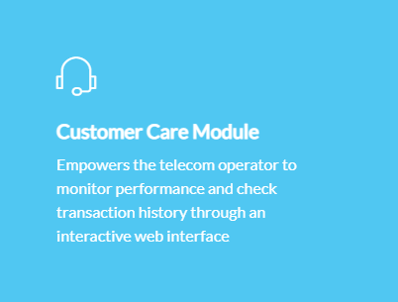
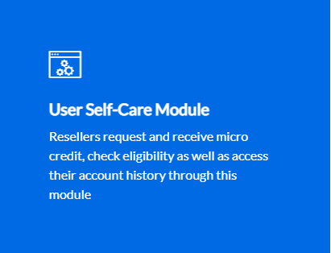
Key Features

Slide 8

what I understand from Micro-credit loan case?
Micro Credit on cell phone balances is very useful to customers which help in having uninterrupted communications.
Targeting the selected customer who are creditable in repaying of Micro Loans help Telecom Company a repetitive cashflow and customer satisfaction is achieved.
Communication being important part no one want to run out of balance and these leading would help in missing out the service blockages and helps in never ending customer lifetime with the brand.
Focus is on providing their services and products to low-income families and poor customers that can help them in the need of hour.

Slide 9

Dataset Information
The dataset is a csv file with 37 attributes (36 features and 1 target).
It has 209593 rows and 37 columns.
The target variable is either 1 or 0 which means non defaulter and defaulter, respectively.
The other key attributes are the account balances, days since last recharge, age on network, median recharge balance for 30 and 90 days and many more. The similar attributes for 30 and 90 days are highly correlated and conveys the same.

Slide 10
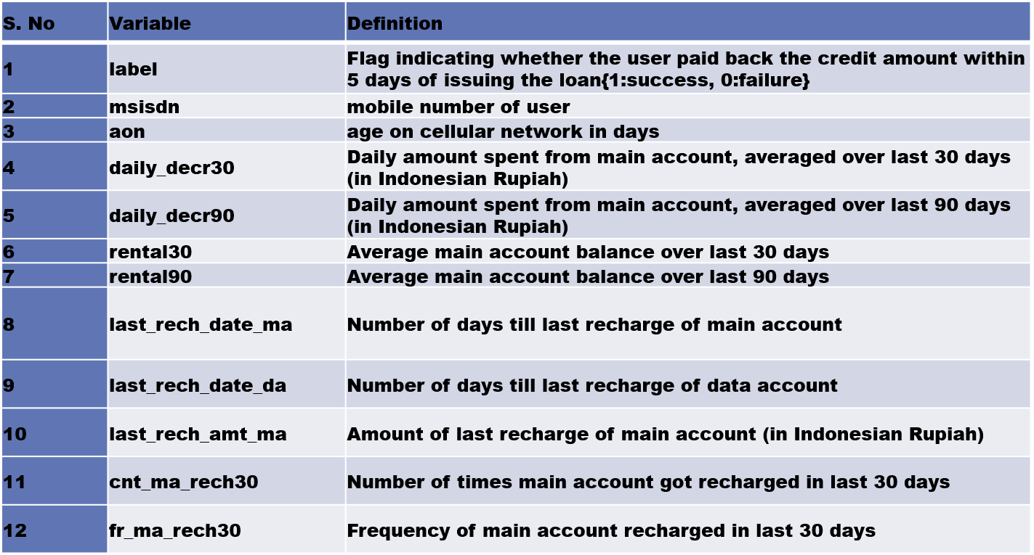

Description of Features

Slide 11
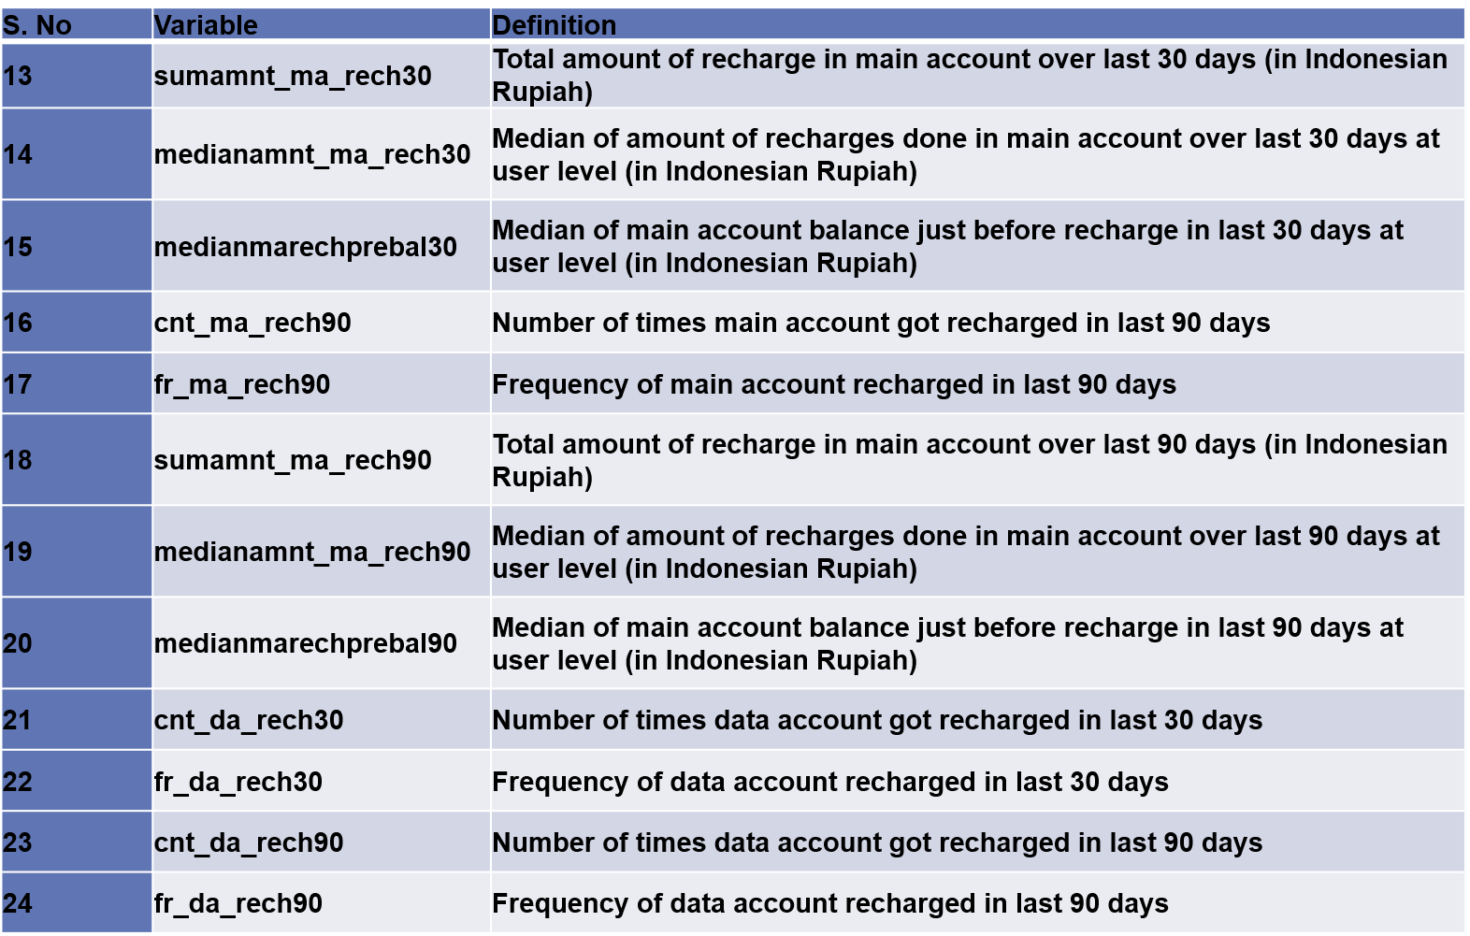
Description of Features

Slide 12
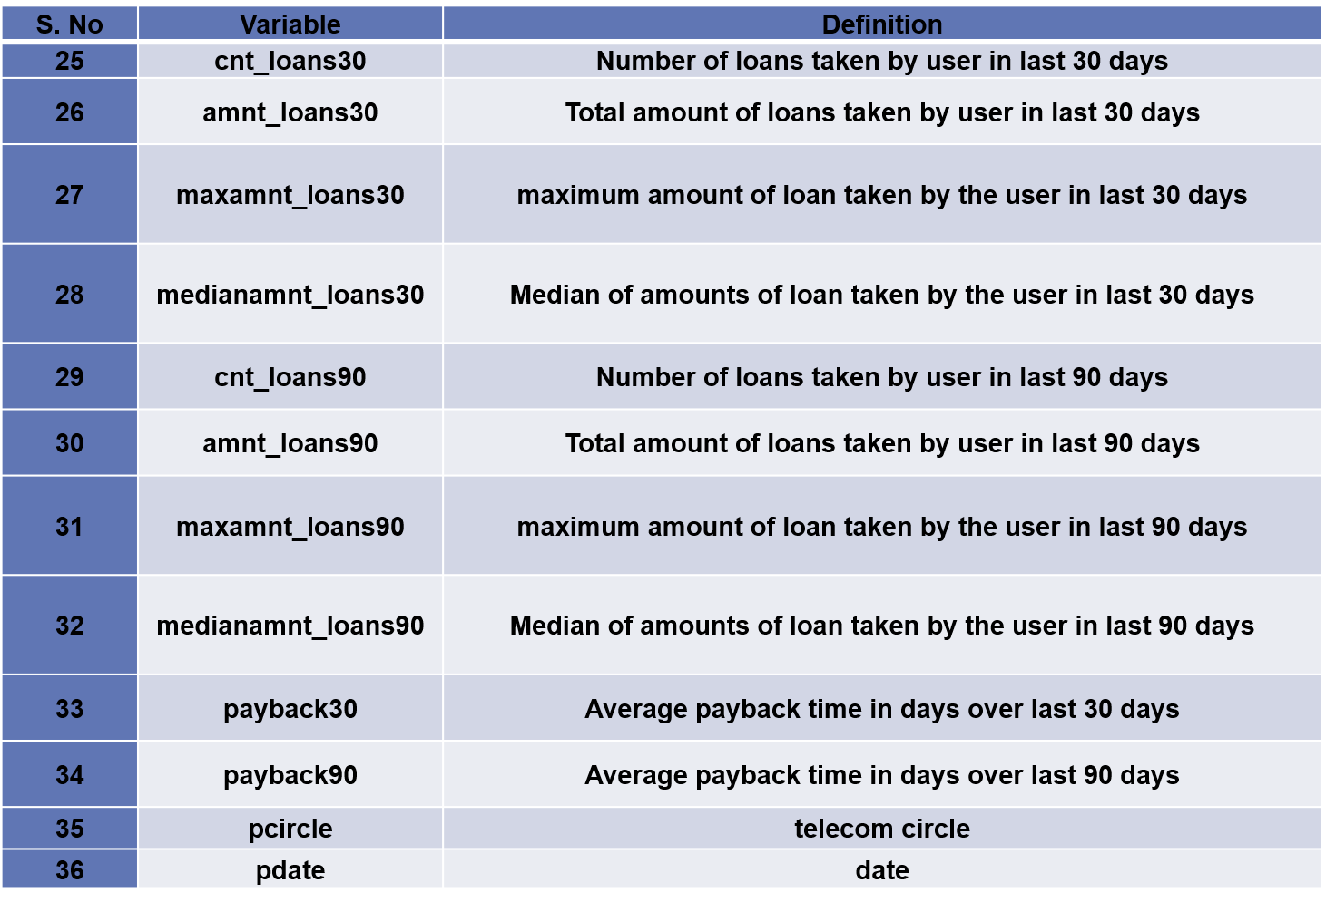
Description of Features

Slide 13
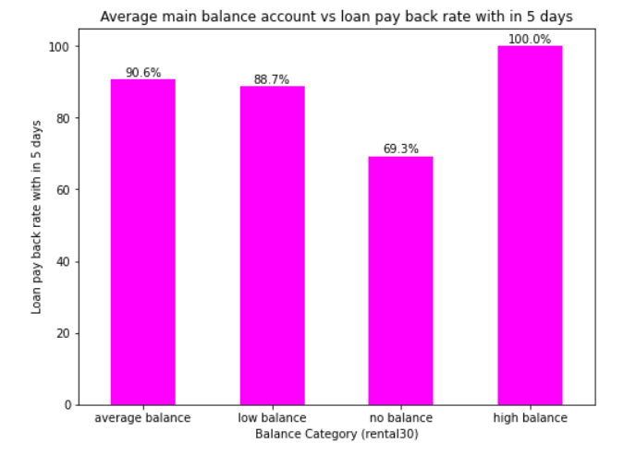
Average main balance account vs loan pay back with in 5 days
observations:-
1- We can differentiate the customers with main balance levels are paying back the loan with in five days.
2- The high balance level people are with 100% rate i.e they are paying loan within 5 days.
3- If talk about average and low balance people ,it is observed that around 10%-12% of people are not paying the loan within 5 days.
4- It is clearly shown that around 30% of low balance level people are not paying back the loan with in stipulated 5 days of time.
5- The 30% of people with no balance or negative balance people are creating a major loss to the company without paying back the loan within five days of time.

Slide 14
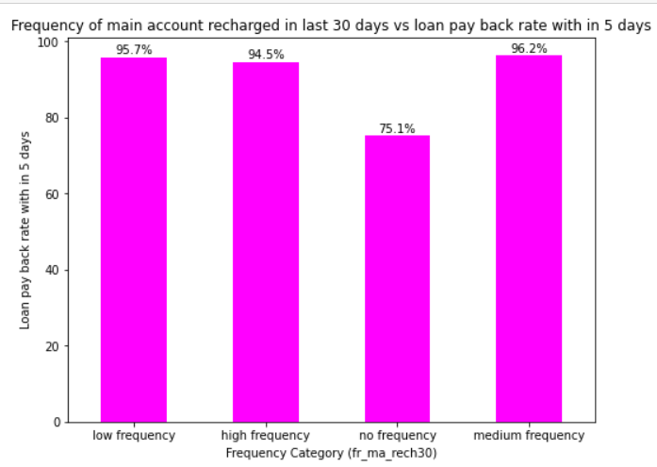
Frequency of main account recharged in last 30 days vs loan pay back rate with in 5 days
Observations:-
1- Customers with different frequency levels (main account recharge) are paying back the loan within five days.
2- There is no 100% rate in any of the frequency levels to pay back the loan within 5 days.
3- Coming to the average and low & medium frequency people it is observed that around 5%-6% of people are not paying the loan within 5 days.
4- Coming to low frequency level people, it is observed that around 25% of people are not paying back the loan with in stipulated 5 days of time.
5- The 25% people who are not getting their main account recharge for 30 days creating a major loss to the company without paying back the loan within five days of time.

Slide 15
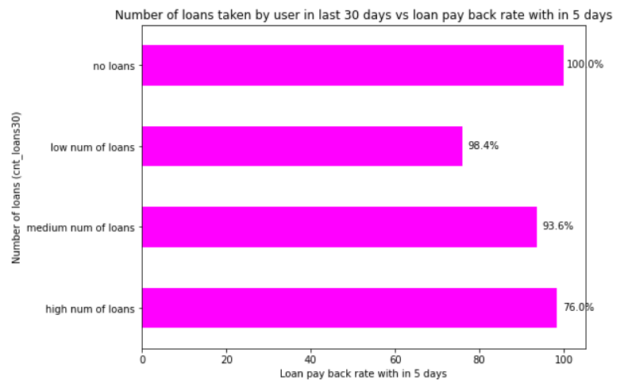
Number of loans taken by user in last 30 days vs loan pay back rate within 5 days
Observation:-
1- Customers with different loans levels taken are paying back the loan within five days.
2- In the data set people not taken loans are labelled as ‘1’. So we should not consider the people with no loans labelled in the above graph.
3- Remaining levels, there is no 100% rate in any of the loan levels to pay back the loan within 5 days.
4- Coming to the high number of loan level people it is observed that around 25% of people are not paying the loan within 5 days.
5- Only 2% of the people from low number of loans category are not paying the loan within 5 days. This is followed by the people with medium number of loans having defaulters of 7% approximately.

Slide 16

Total amount of loans taken by user in last 30 days vs loan pay back rate within 5 days
Observations:-
1- In the data set people not taken loans are labelled as ‘1’. So we should not consider the people with no loans labelled in the above graph.
2- Remaining levels, there is no 100% rate in any of the loan levels to pay back the loan within 5 days.
3-Coming to the low amount level people it is observed that around 25% of people are not paying the loan within 5 days.
4-Only 2% of the people taken high amount of loans are not paying the loan within 5 days. This is followed by the people with medium number of loans having defaulters of 7% approximately.
5- As 'msisdn', 'pcircle', 'pdate' features are not having much importance, we can ignore them. And also removing the extra columns created for the EDA part.

Slide 17
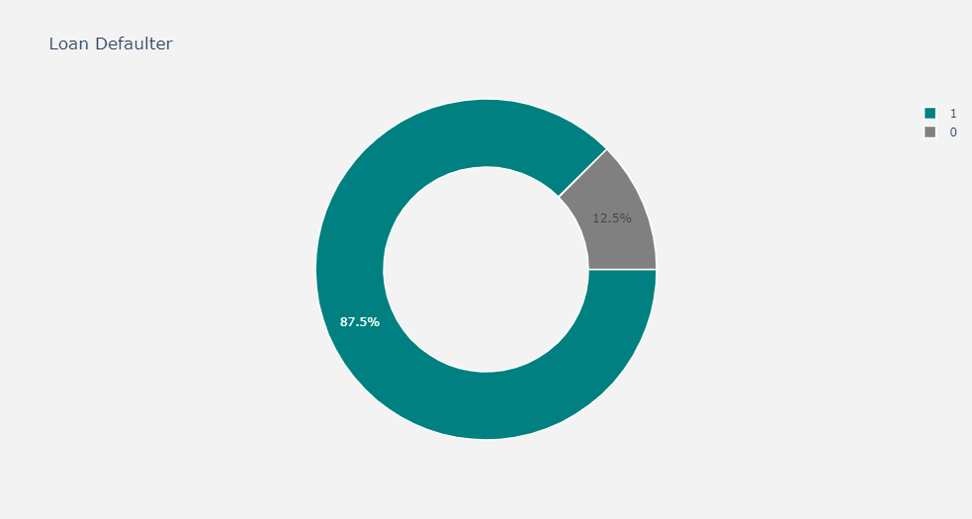
Total percentage of defaulters and non-defaulters customers
In this pie chart
0- shows loan defaulters customers.
1- shows percentage of loan non- defaulters customers
from the output, we can see that 87.5 % customers are Non Defaulter & 12.5 customers are Defaulter

Slide 18
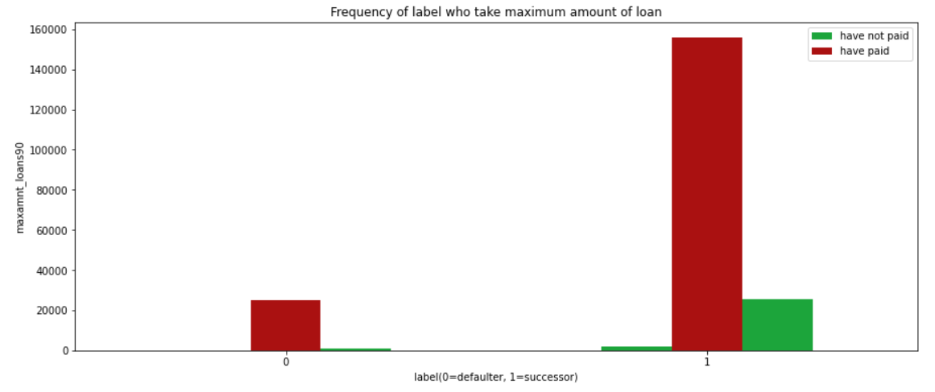
Frequency of label who take maximum amount of loan
From the graph it is clear that:
1- More than 1,55,000 customers has pay back their loan.
2- The total number of non-defaulter customers are very less.

Slide 19
Steps and assumptions
Ensuring outliers are treated properly, pca will perform and dataset is ready for model testing.
X and Y variables are assigned with Independent data and Target data.
Import libraries like sk.learn linear model, Decision Tree, Random Forest Regressor and other libraries.

Slide 20

MODELs DEVELOPMENT AND EVALUATION
Testing of Identified Approaches (Algorithms)
lr = LogisticRegression()
gnb = GaussianNB()
knc = KNeighborsClassifier()
dtc = DecisionTreeClassifier()
rfc = RandomForestClassifier()
gdc = GradientBoostingClassifier()
ada = AdaBoostClassifier()

Slide 21
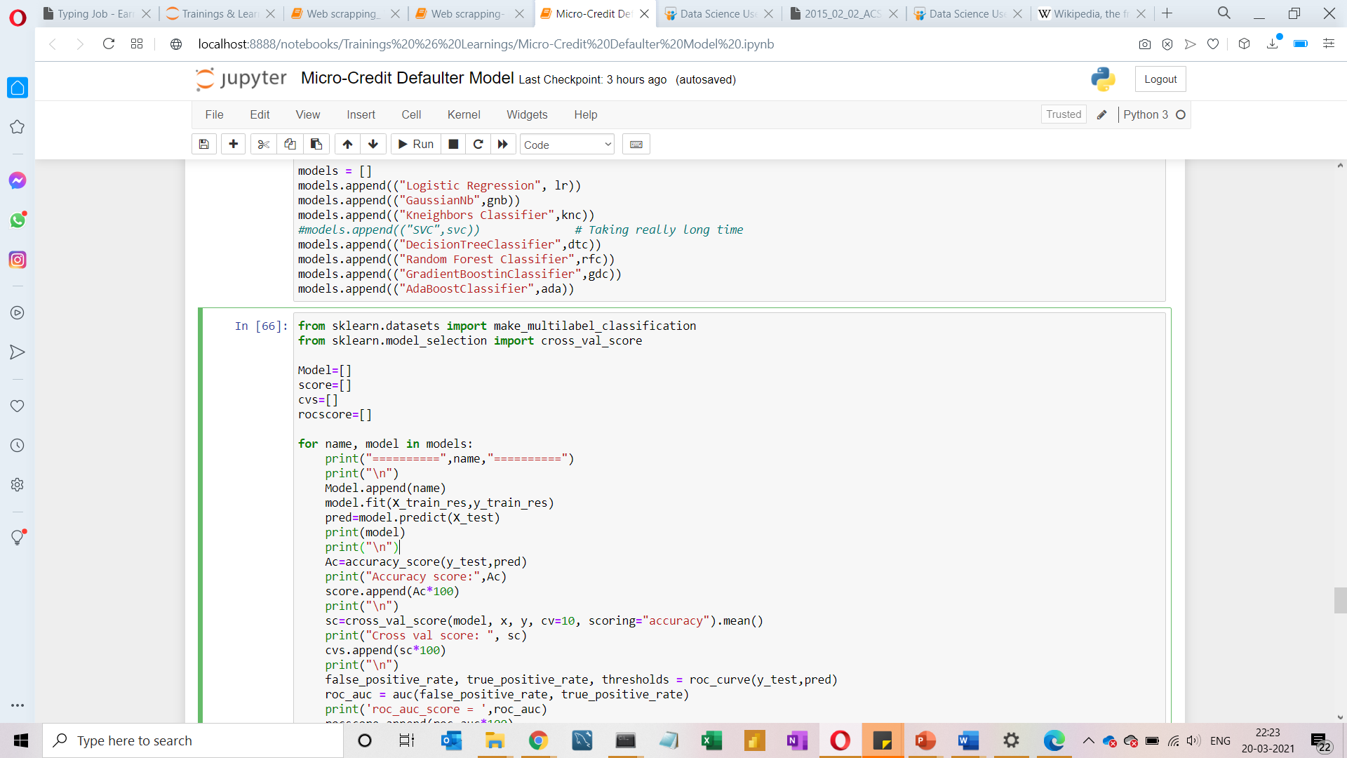
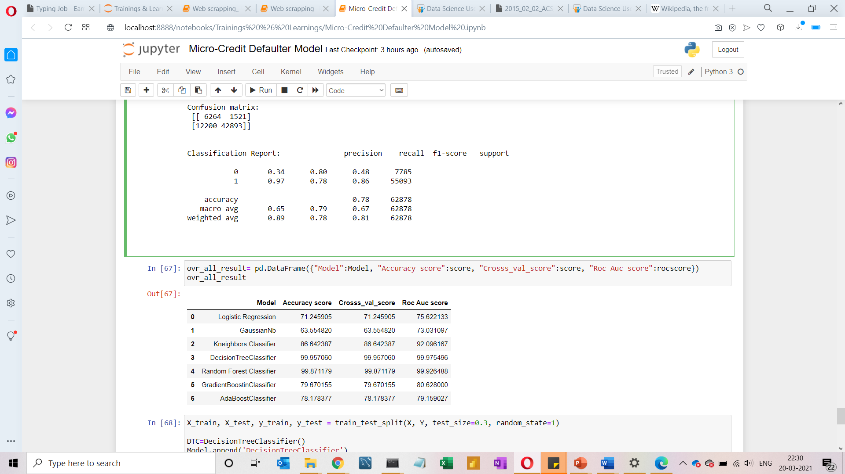
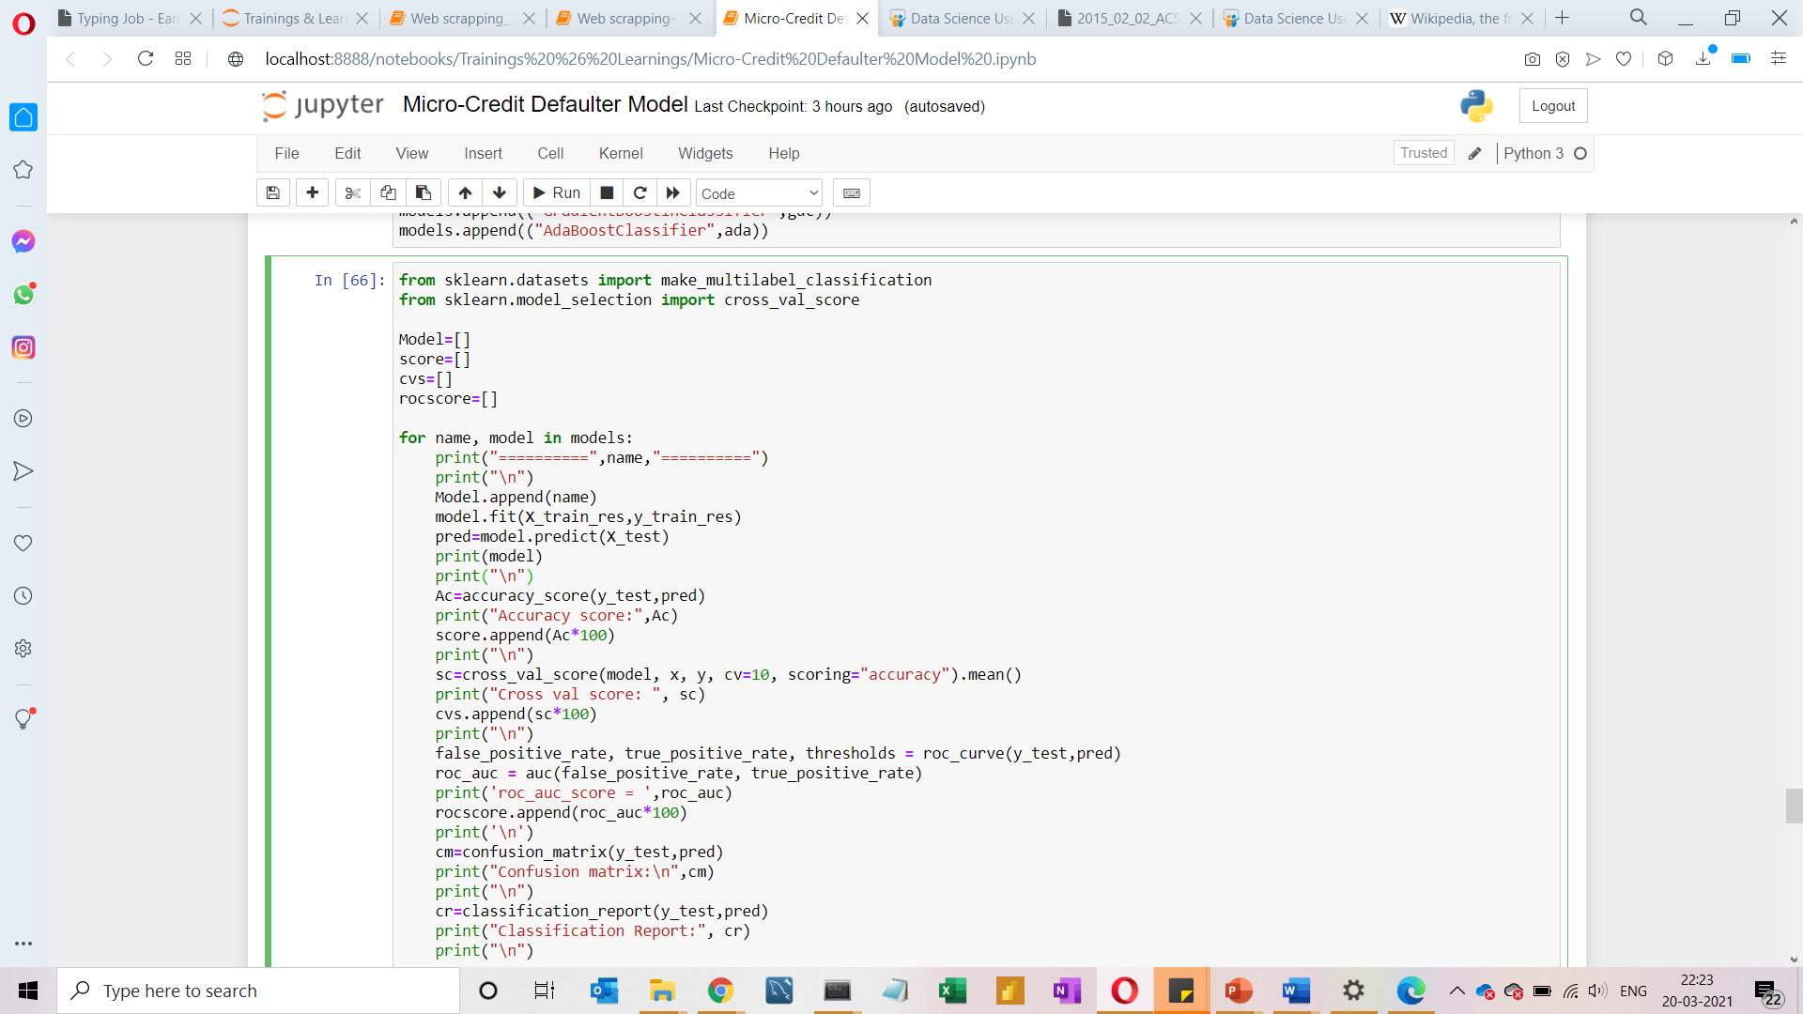
MODELS DEVELOPMENT AND EVALUATION
Run and Evaluated Some Selected models

Slide 22
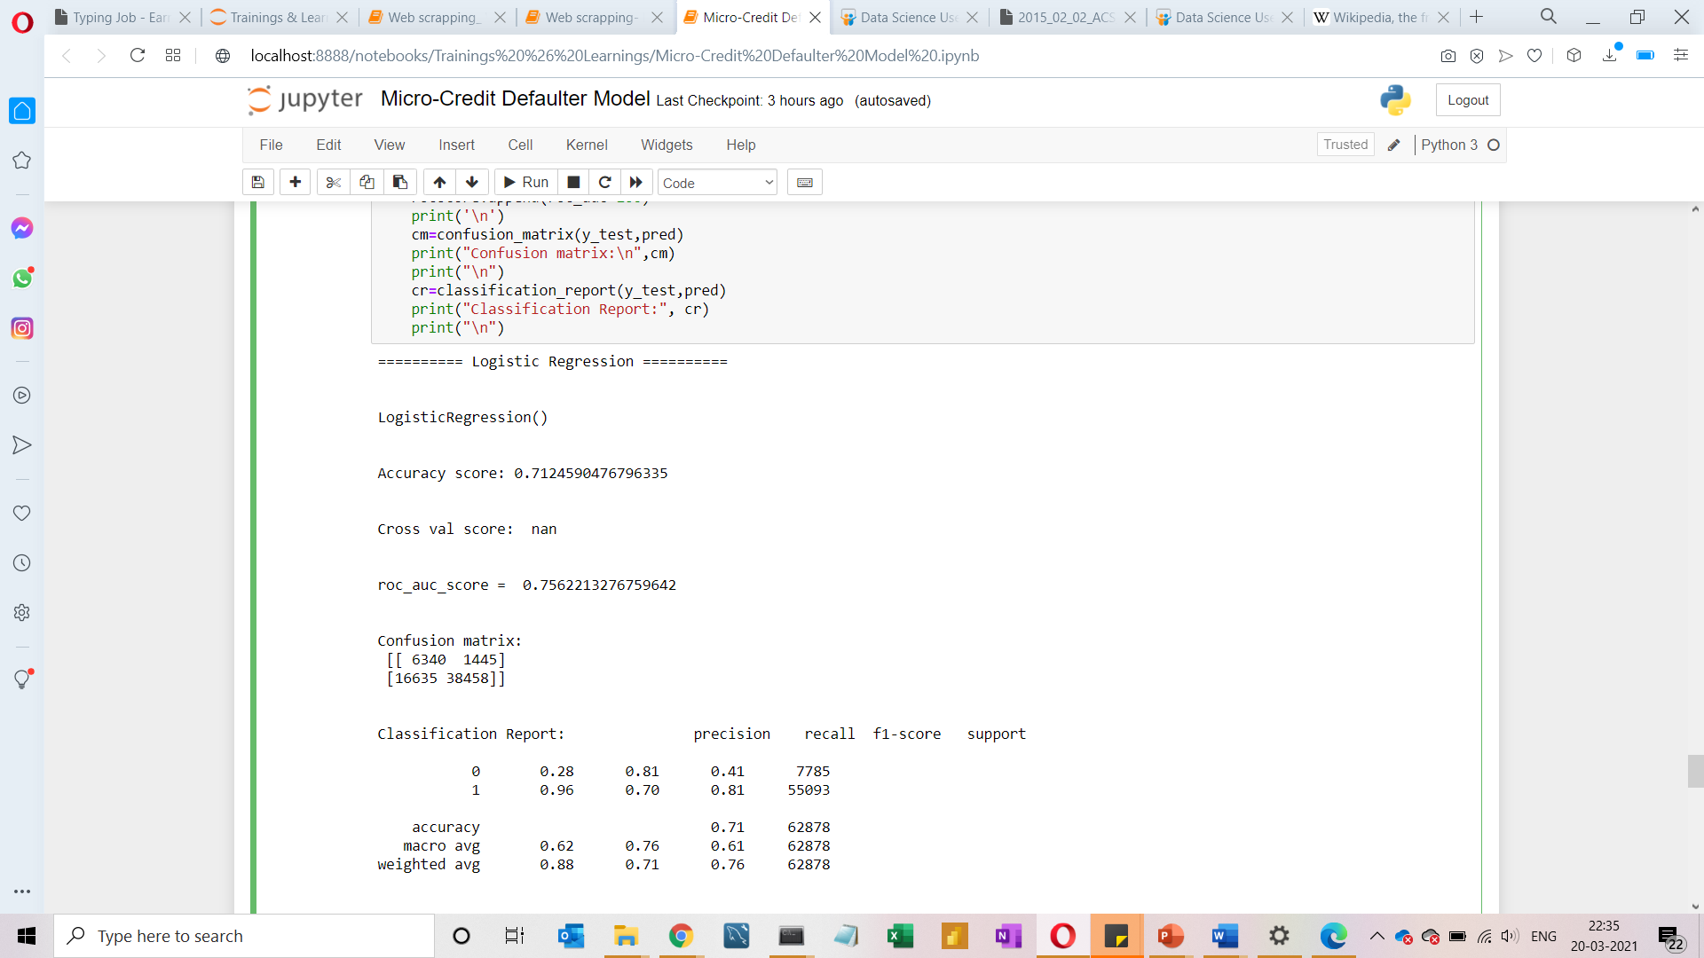
MODELS DEVELOPMENT AND EVALUATION
Logistic Regression

Slide 23
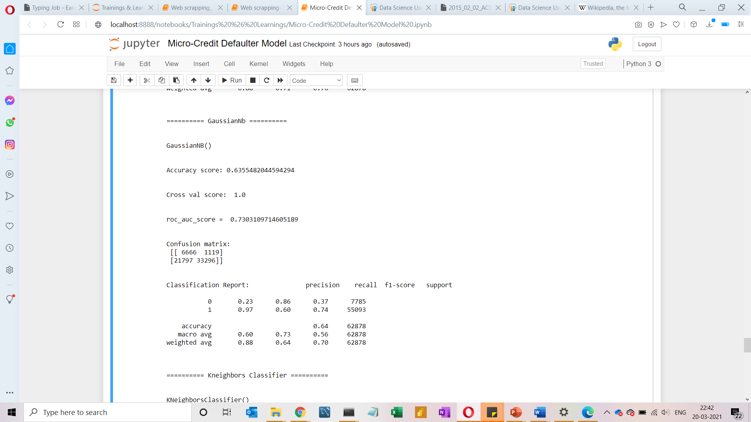
MODELS DEVELOPMENT AND EVALUATION
Gaussian Nb

Slide 24
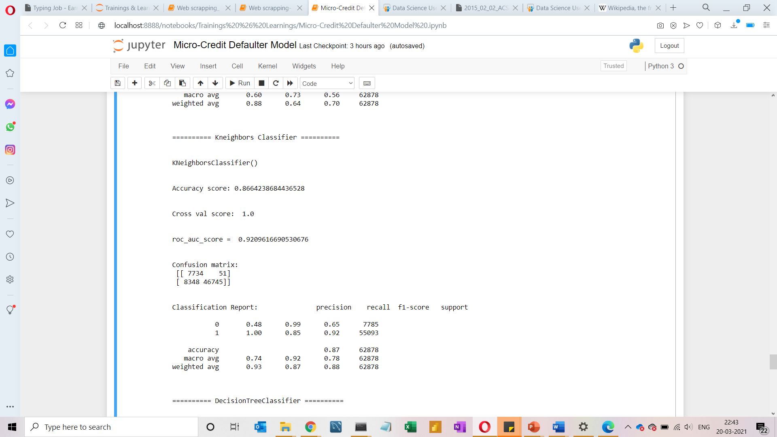
MODELS DEVELOPMENT AND EVALUATION
kNeighbors Classifier

Slide 25
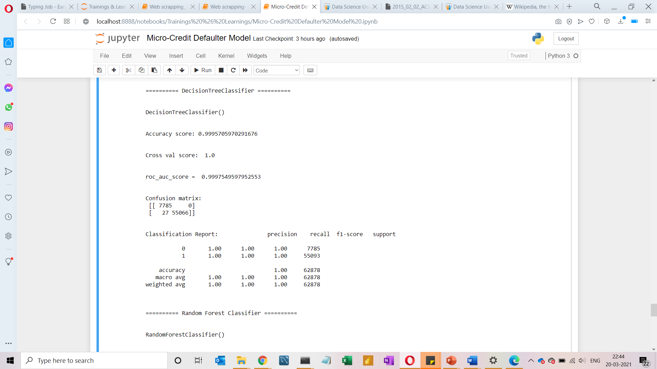
MODELS DEVELOPMENT AND EVALUATION
Decision Tree Classifier

Slide 26
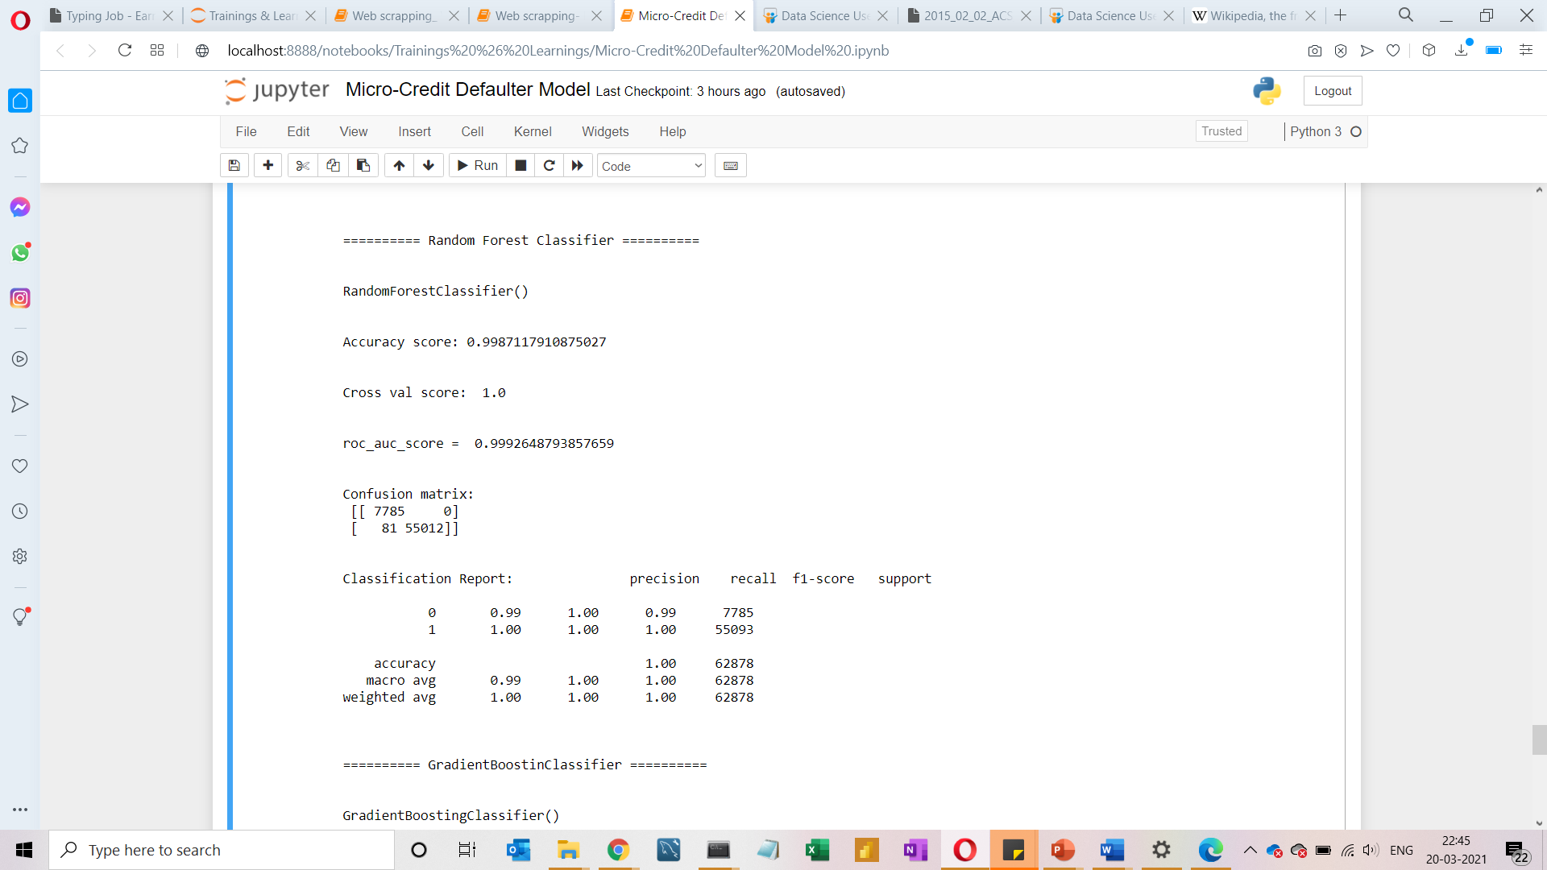
MODELS DEVELOPMENT AND EVALUATION
Random Forest Classifier

Slide 27
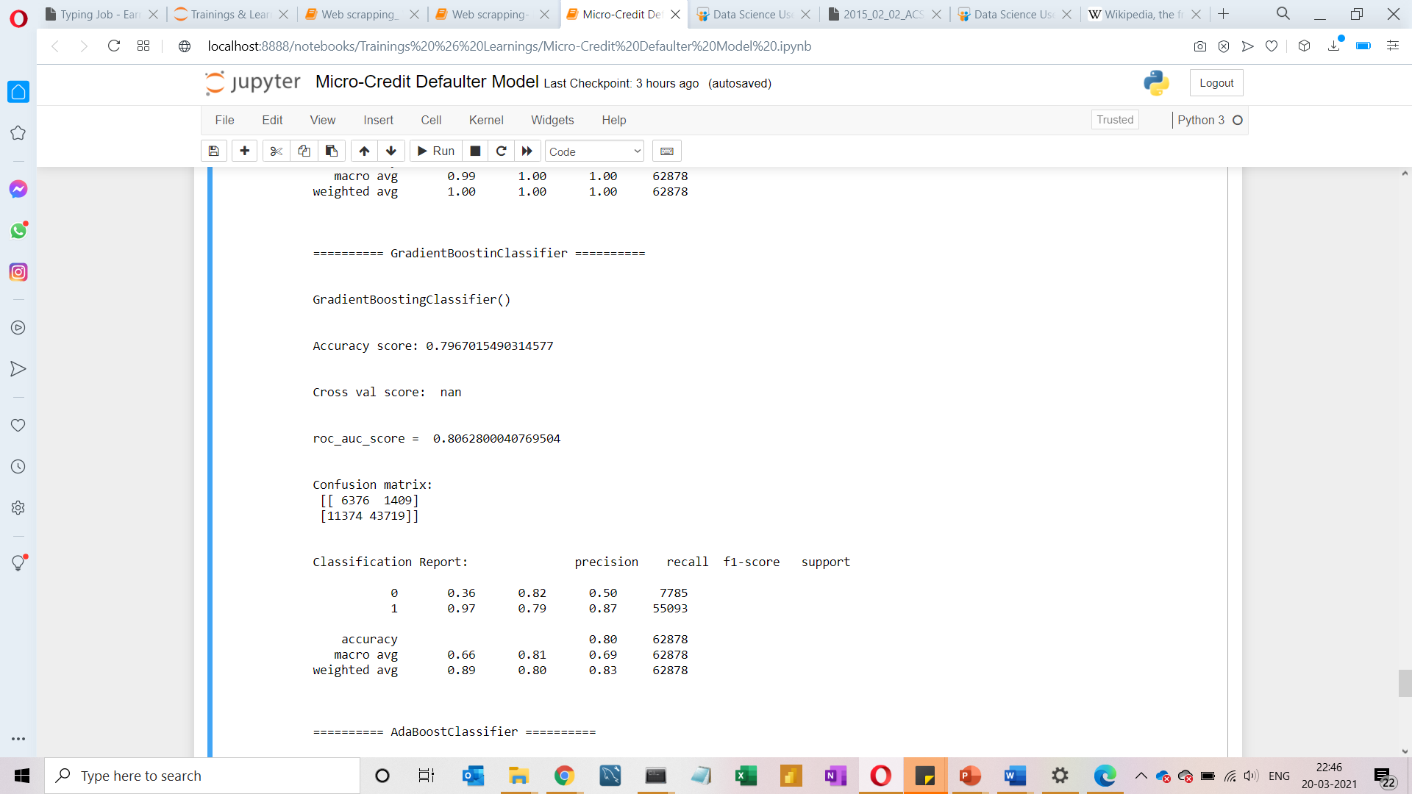
MODELS DEVELOPMENT AND EVALUATION
Gradient Boosting Classifier

Slide 28
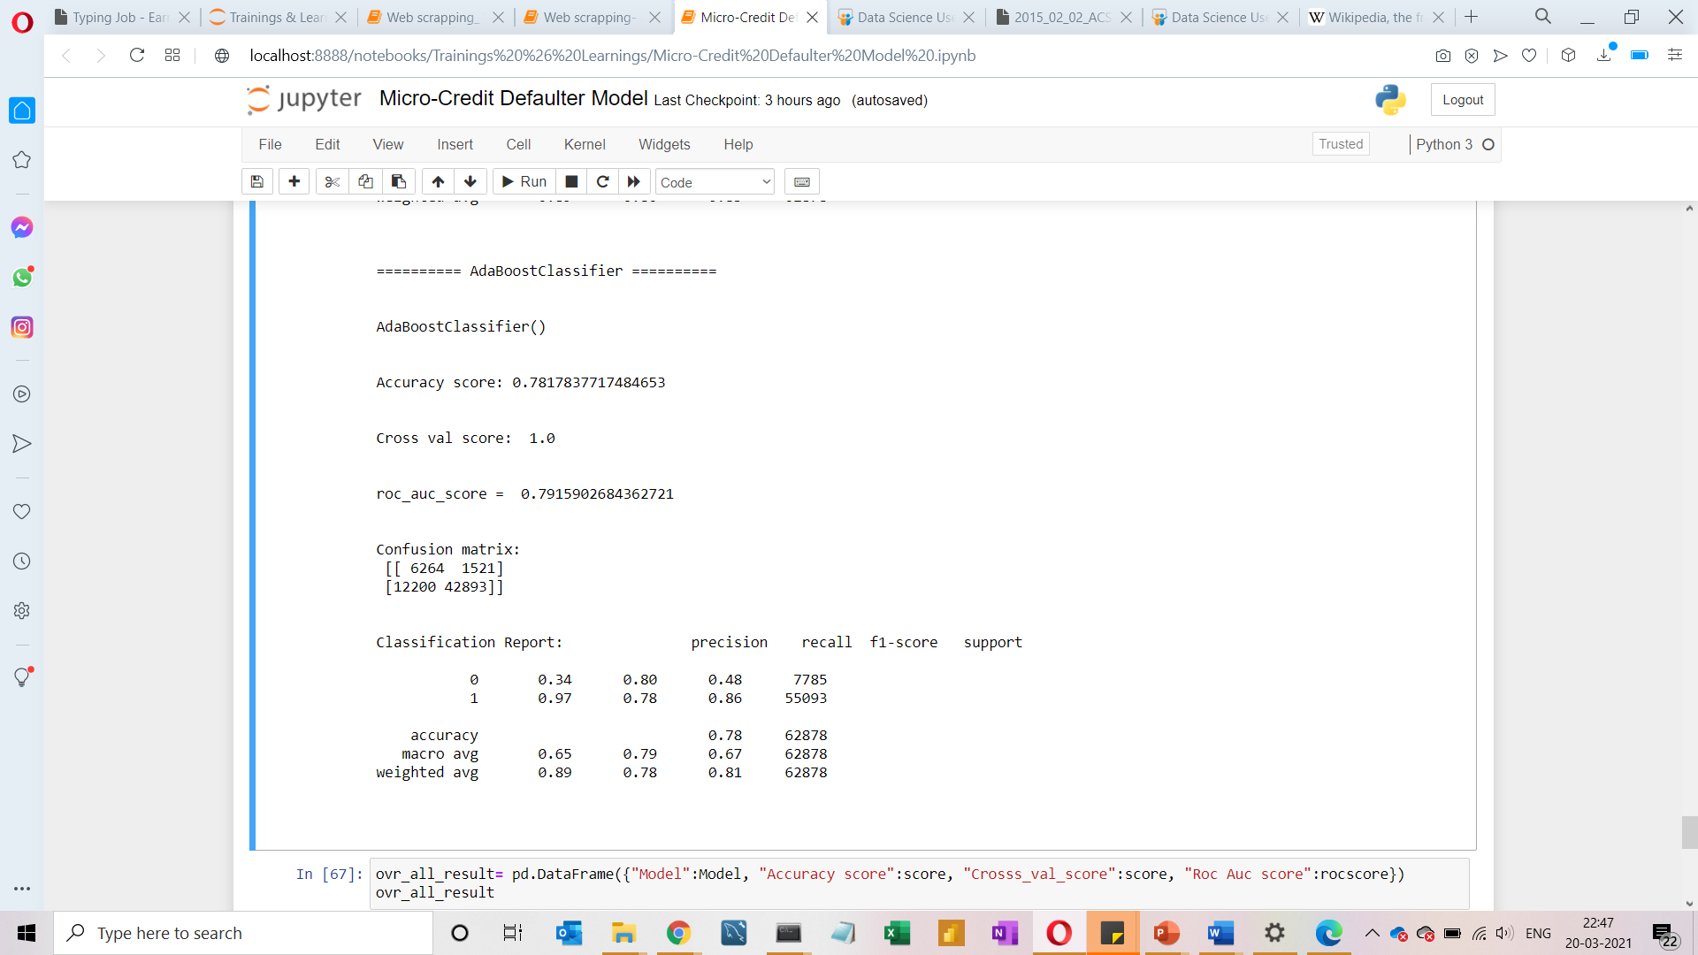
MODELS DEVELOPMENT AND EVALUATION
Ada Boost Classifier

Slide 29
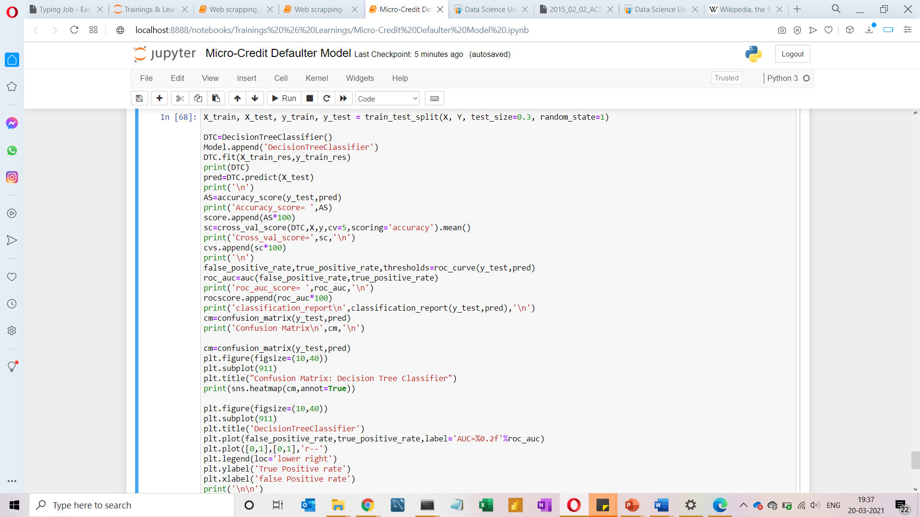
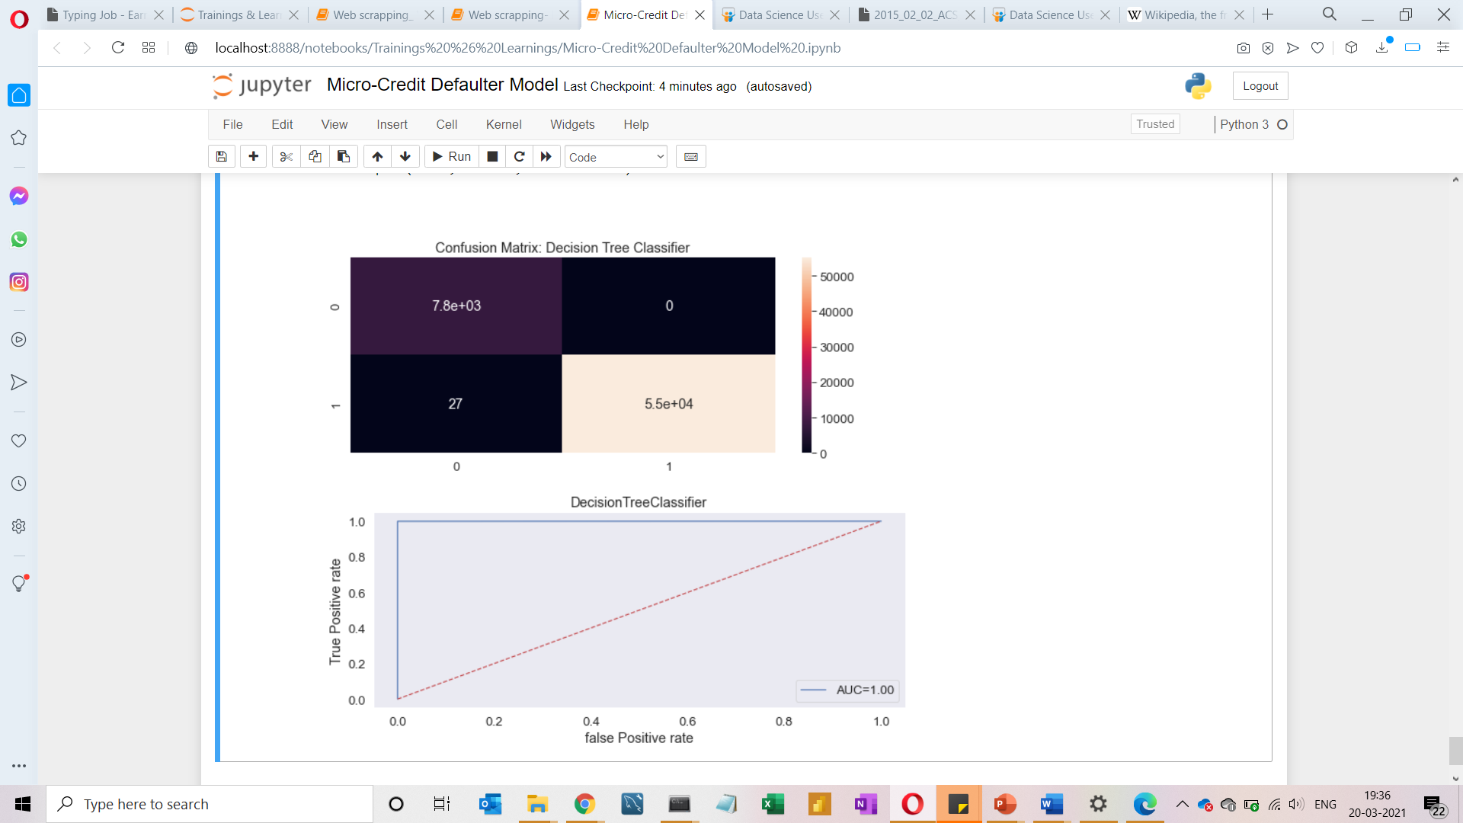
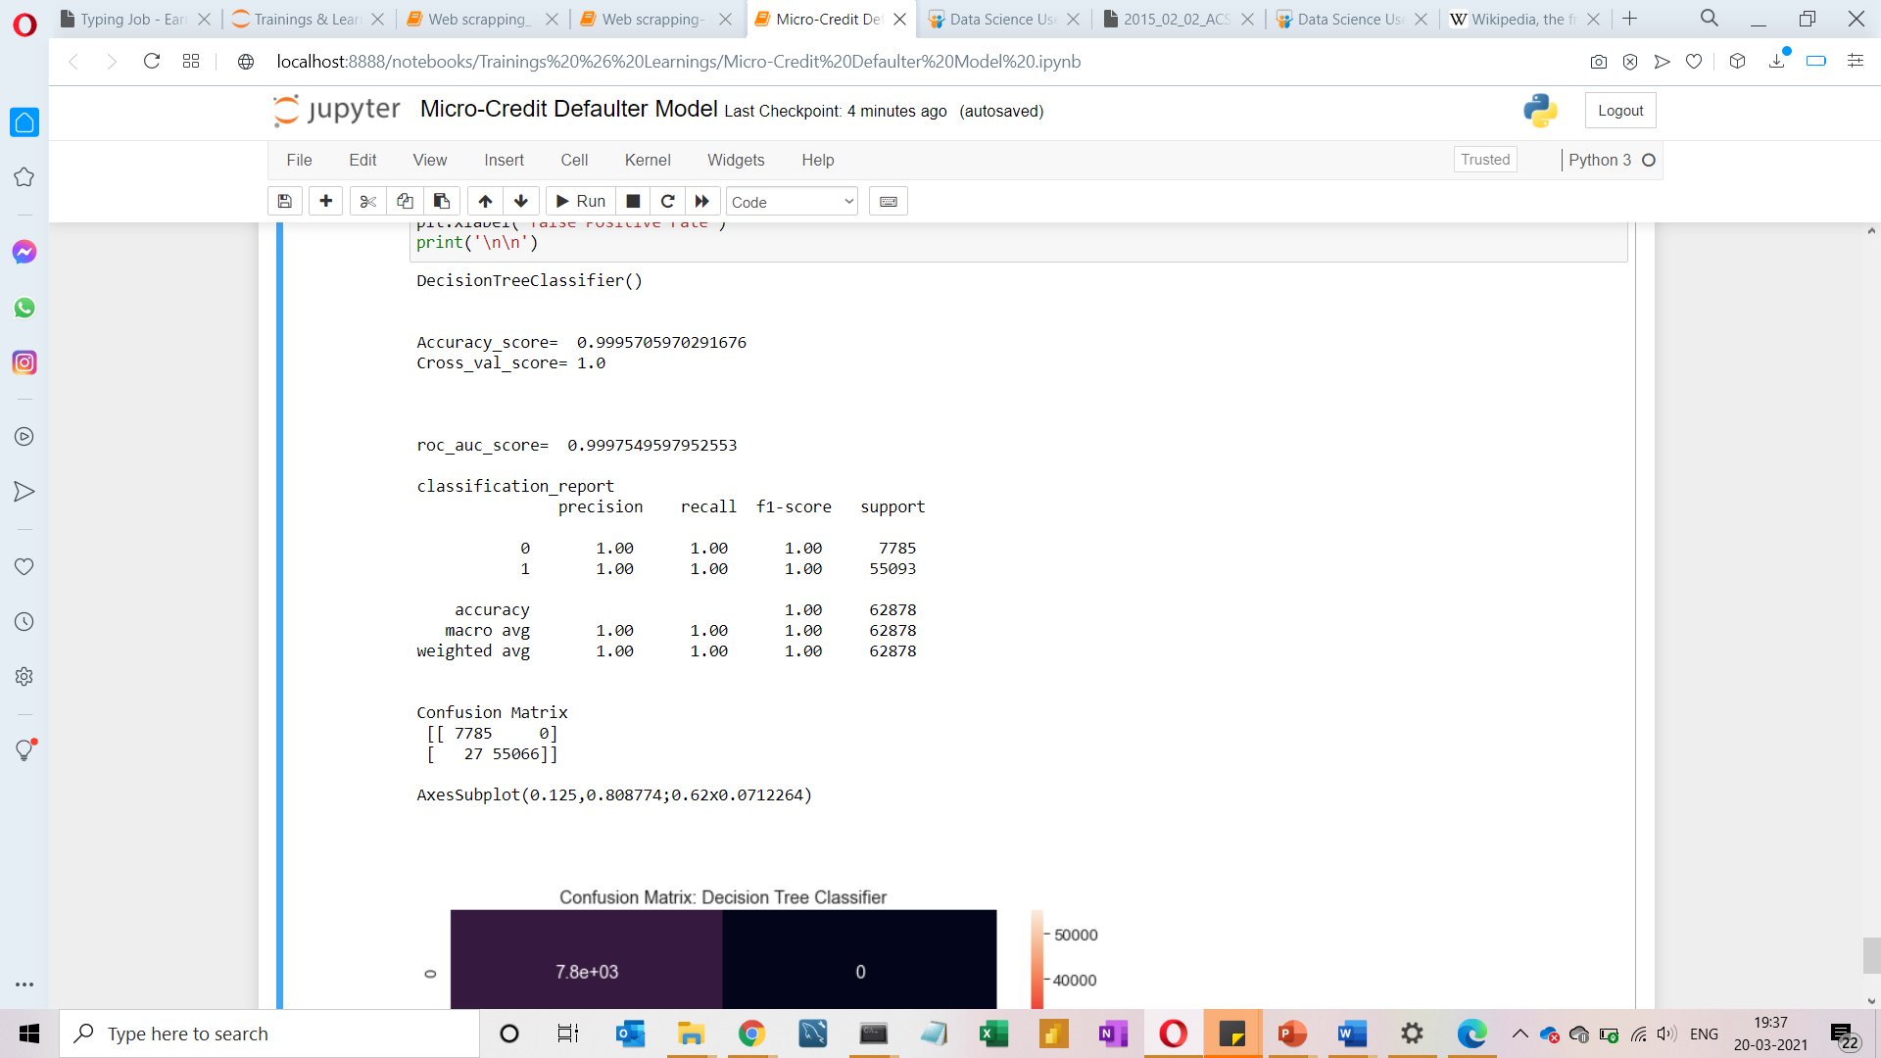
Model dashboard

Slide 30
Model Performance
Predicted is having high-level of accuracy.
Decision tree model is the best model when compare with other models.
Having the error 0

